Slide 1
CSE 325: Information System Design
Week 1: Requirement Analysis (Gathering)
Novia Nurain

Slide 2
Requirement Gathering Methods
Direct user engagement
Observation
Interviews
Focus groups
Contextual inquiries
Survey & questionaries
Collaborative and Participatory method
Participatory design
JAD/JDP (Joint Application Development / Joint Design Planning

Slide 3
Requirement Gathering Methods
Analytical and Modelling methods
Task analysis
BPMN (Business Process Model and Notation)
Journey Mapping/Experience Mapping
Secondary Methods
Document & Artifact analysis
Domain/Market analysis
Competitive analysis

Slide 4
Requirement Gathering Methods
Direct user engagement
Observation
Interviews
Focus groups
Contextual inquiries
Survey & questionaries
Collaborative and Participatory method
Participatory design
JAD/JDP (Joint Application Development / Joint Design Planning

Slide 5
Observation

Slide 6
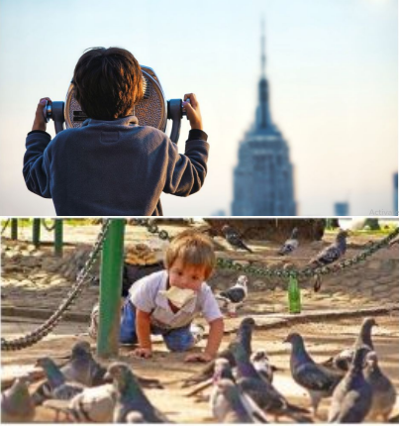
Observation
Observation is a method in which a team member observes stakeholders’ behavior as they use a similar or competitor’s product.
This method is useful for identifying pain points and areas for improvement in the product.

Slide 7

Participant Observation
Involves the researcher observing the participants’ activity by entering the community (place) and by actively taking part into the observed activity.
Researchers use this method to understand a phenomenon by experiencing it themselves.

Slide 8
Participant Observation
Pros
The researcher has hands-on experience and is able to get into the meanings, viewpoints, values, and problems of the observed phenomena
Provide a provision to develop insights where questioning is ineffective
Cons
Being actively part of the activity researcher may develop empathy towards the observer, which may result in bias.
May give rise to several ethical concerns.
It is time-consuming.

Slide 9

Non-Participant Observation
Involves the researcher observing the participants’ activity by entering the community (place), however, being completely separate from the observed activity
Researchers use this method to understand a phenomenon by viewing what is going on with their own eyes

Slide 10
Non-Participant Observation
Pros
Allows the researchers to be more open-minded, as they are not being sympathetically involved into the observed phenomena.
Allows the researcher to make judgments and observe body language.
Cons
As researchers are not actively taking part in the observed phenomena, hence, there is a chance that the researchers may end up not getting accurate data for observing from a distance.
It is time-consuming.
People may change their behavior if they are informed being observed

Slide 11
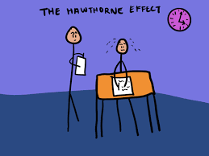
Hawthrone Effect (Observer Effect)
Individuals modify an aspect of their behavior in response to their awareness of being observed
Named for experiments on the Hawthrone Works factories in the 1920s & 1930s
How might you avoid the effect?
- build rapport with the participants
- normalizing the observation
- use multiple methods

Slide 12
Interviews

Slide 13
Interview Formats
3 general interview types
 | Unstructured Interview | Semi-Structured Interview | Structured Interview
 | little knowledge about the interview topic no guide and exploratory in nature due to high flexibility, off the cuff go with the flow, the interview becomes the apprentice / learner | some knowledge about the interview topic a less strictly defined guide with themes and questions you want to learn about deviations are allowed and encouraged → probing but staying on topic | lots of knowledge about the interview topic strictly defined list of interview questions no deviations are allowed from topic or questions across interviews or participants
Interview Formats

Slide 14

Let’s look at an interview
What do you think about this interview?
What did you like?
What could be better?
http://www.youtube.com/watch?v=U4UKwd0KExc

Slide 15
Interview Tips
Aim for participants to be comfortable
Let participants finish their thoughts
Make them feel heard
-take notes, give eye contact, offer acknowledgments like “I see” or repeating them •
Show empathy (but be genuine) •
-“That must have been frustrating”, “I’m sorry that happened to you”

Slide 16
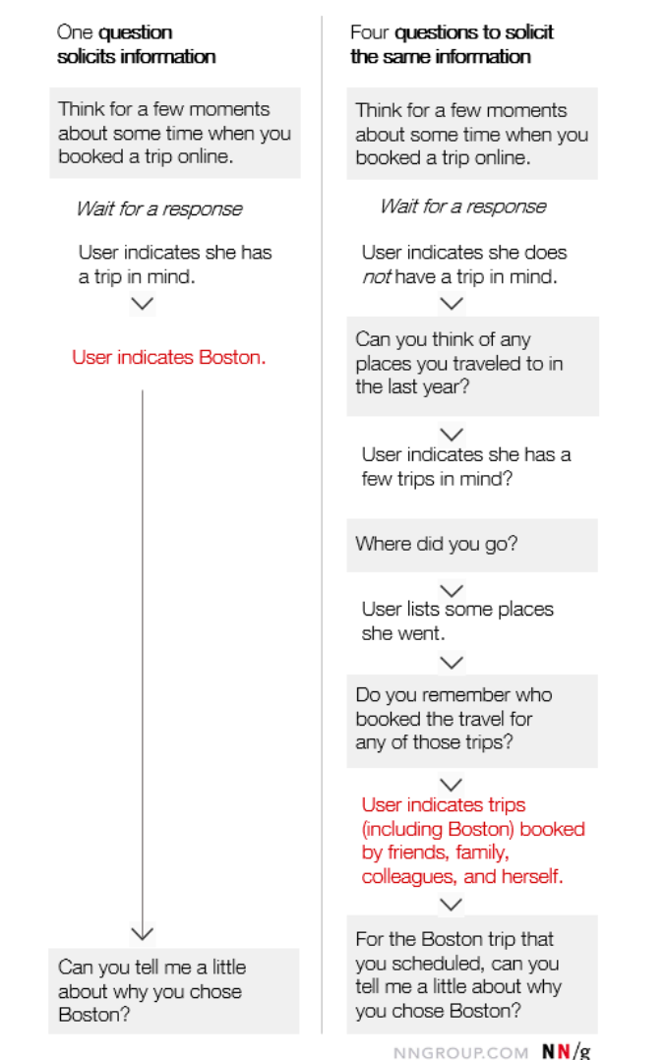
Interview Tips
Have questions prepared ahead of time (a guide)
-But allow yourself to go off-script if appropriate
Anticipate different responses
-If a participant has or has not experienced something, used a technology, etc.
https://www.nngroup.com/articles/user-interviews/

Slide 17
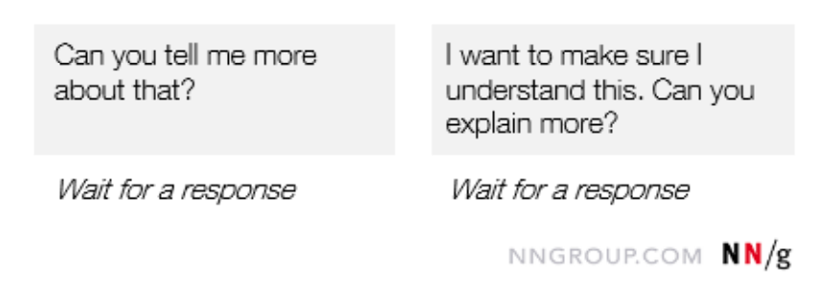
Interview Tips
Avoid leading questions
-Bad: “Why do you enjoy using the Acme product so much?”
-Better: “Why do you use the Acme product?”
-Bad: “What do you like about X?”
-Better: “What do you think about X?”
Avoid closed questions
-Bad: “So, you use the Acme product every morning?”
-Better: “Can you tell me about how you use Acme?”
Practice follow-up questions
Prompts are good ways to get participants to say more
- Silent, echo, agreeing, tell me more, clarifying
https://www.nngroup.com/articles/user-interviews/

Slide 18
Interview Stages | Preparation
1. Research your study participant
You have to come in with lots of knowledge about the person and the topic.
2. Prepare a set of themes to explore, draft an interview protocol
Determine the order that would allow the conversation to flow most naturally.
3. Be participant-centered
Ask what day, time, and location works for the individual you would like to interview.
4. Be early, be prepared
Make sure you know where you are going and be 10 minutes early. You want to make a good impression.
5. Define roles beforehand
Ideally two team members participate in the session: one leads the interview (ask questions), while the other takes notes and photographs (if appropriate). Ask for permission to audio record the interview.
Notes:
From the reading – creating questions:
Identification of the domain
Leadoff Question
Covert Categories
Follow-up Questions
Magic Words
You have to come in with lots of knowledge, about the person, about the topic. Interviewees only have so much time so use it wisely. Don’t waste it by finding out information was available elsewhere; you want to get beyond information that’s publicly available.
WHY prepare for an interview
Time with users is precious; you need to make the most of it! While you must always allow room for the spontaneous conversation. it is imperative to plan your interviews. You may not get to every question you prepare, but you should come in with a plan for engagement.
Take a few moments to make sure that you leave room in your planning to ask plenty of “why?” questions, plenty of “tell me about the last time you …?” questions, and plenty of questions that are directed at how the user feels.
The interviews should happen in the context of the target activity
Ask them where they want to be interviewed, look around and decide what to ask to proceed the discussion, powerful way to tell stories, tell me about this picture,
Context helps explain the inconsistencies between what people think, say, and do
“If you want to understand how a lion hunts, don’t go to the zoo. Go to the jungle.” -FRANK CHIMERO
Make sure you’re prepared to capture. If you’re not interviewing in pairs, you should use a voice recorder (ask for permission)—it is impossible to properly engage a user and take detailed notes at the same time.
Prevent intimidating environment! (as the interviewer, YOU are in the position of power). Make them feel comfortable
https://unsplash.com/photos/9dF7pCyaM9s

Slide 19
Interview Stages | Execution
1. Introduce the project and yourselves
A good interview is a friendly conversation. Briefly describe your research and the goals of the interview.
2. Dig for stories, feelings, and emotion
Even when you think you know the answer, ask people why they do or say things. Ask open-ended questions, and continually ask the participant to provide concrete examples. Try not to say usually when asking a question. Instead, ask about a specific instance or occurrence.
3. Notice inconsistencies but don’t correct them
Sometimes what people say and what they do are different.
4. Pay attention to nonverbal cues
Take notes of what they say and what they don’t say. Be aware of body language and emotions.
Notes:
Do not rush into the questions, care about the topic and the participant.
Introduce yourself, share something about yourself, but make sure to move the focus to the participant. Watch for their body language to relax before you move on.
Be charming, positive, and reassuring. Be genuinely interested in what they are saying.
A good warm up question: tell me about the first time you did something that you loved
Whether or not the stories people tell are true, they reveal how they think about the world. Ask questions that get people telling stories. If not naturally storyteller: tell me the story of your last time …, can you tell me what happened. Encourage storytelling by often asking ‘why’ or saying ‘tell me more’
Help them be specific. Do not ask “what is your average day” instead ask “what happened the last time…”
Follow up by asking:
Can you tell me about?
Say more…
Why?
Wrapping up
Look for any conflict or inconsistency (based on your notes), and ask for explanation.
Go back to any points of conflict or inconsistency (based on your notes), probe for resolution or explanation.
Ask follow up questions on any topic that requires more detail or information.
Ask for follow up interview if necessary
Share your finding with them: tell them you will get back in touch toward the end of the semester
https://unsplash.com/photos/NVWyN8GamCk

Slide 20
Interview Stages | Execution Common mistakes! [Don’t do these]
Avoid compound questions. E.g. How often do you check Snapchat and what is the reason? Also, tell me how do you gather information and who do you ask for help?
Avoid leading/directive questions/ binary questions. These questions may imply that there is a right answer or lead respondents to answer in a particular way. E.g. Besides this website, what are other trusted sources? Friends?
Don’t fall into trap of leading expressions. E.g. nodding, saying aha, that’s great, interesting, yeah, I see, etc. Yet you have to balance with not being deadpan.
Don’t suggest answers to your questions. Even if they pause before answering, don’t help them by suggesting an answer.
Don’t be afraid of silence. Allow for silence, they may reflect on what was just said and reveal something deeper.
Notes:
When people first start interviewing, they fall into certain trap of leading interviewees by nodding, saying aha, that’s great, interesting, yeah, I see, thanks.
Don’t let the information that they get surprises you too much. Never too surprised or too bored. Look interested.
Don’t suggest answers to your questions. This can unintentionally get people to say things that agree with your expectations.

Slide 21

Let’s look at an interview … again
How to do an Interview
What was different in this interview in comparison to the first interview you saw?
http://www.youtube.com/watch?v=eNMTJTnrTQQ

Slide 22
Focus Groups

Slide 23

Focus groups: Benefits
Participants with similar goals or perspectives can build on each other’s responses or recall experiences in greater detail
They can help teams clarify users’ mental models and language (vocabulary)
They are a time-efficient method for the researcher
When run properly, they can yield rich qualitative insights

Slide 24
Focus groups
A focus group is a qualitative research method in which
a facilitator conducts a meeting or workshop (typically about 1–2 hours long) with a group of 6–9 people
discuss issues and concerns about their experiences with a product or service
The term “focus” relates to the role of the facilitator, who maintains the group’s focus on certain topics during discussions.

Slide 25
Focus groups: Risks
Group dynamics may impact how much (or how little) people share

Slide 26
Focus groups
You can run an effective focus group by
recruiting participants that are representative of your target audience(s)
Treat your focus group like a workshop. Make participants comfortable with participating, verbally or nonverbally
Easy warmup activity
Both written and verbal participation opportunities
Have a (written) plan and guide

Slide 27
Focus groups
Link: https://youtu.be/e9nZRMN49J0

Slide 28
Contextual Inquiry

Slide 29
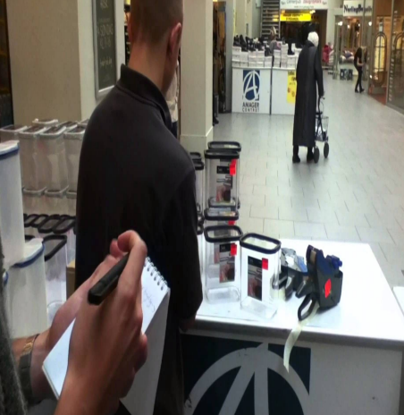
Contextual Inquiry (CI)
Can be thought of as applied design ethnography
“The core premise of contextual inquiry is very simple:
go where the customer works,
observe the customer as he or she works, and
talk to the customer about the work.
Do that, and you can’t help but gain a better understanding of your customer.”
• Effectively, observation + interview

Slide 30
Contextual Inquiry (CI): Four principles
Context
Partnership
Interpretation
Focus

Slide 31
Four Principles of CI: Context
Must be “where the work happens”
Useful for understanding the underlying work structures rather than people’s perceptions of those structures

Slide 32
Four Principles of CI: Partnership
Aim to follow a master/apprenticeship model
You’re the apprentice, watching and asking questions to understand why things are done a certain way
The transfer of knowledge happens when people talk about how they work while they’re doing the work

Slide 33
Four Principles of CI: Interpretation
All data must be interpreted for meaning before developing design implications
Merge insights from your observations with insights from your questions
Double-check your interpretations with your participants, where participants are allowed to make changes

Slide 34
Four Principles of CI: Focus
Usually, researcher enter the filed with a narrower focus, but bee open to expanding on your initial focus or assumptions
Any time you’re surprised by a participant or find their actions odd, it’s an opportunity to ask questions
Aim to see their perspective rather than your own

Slide 35
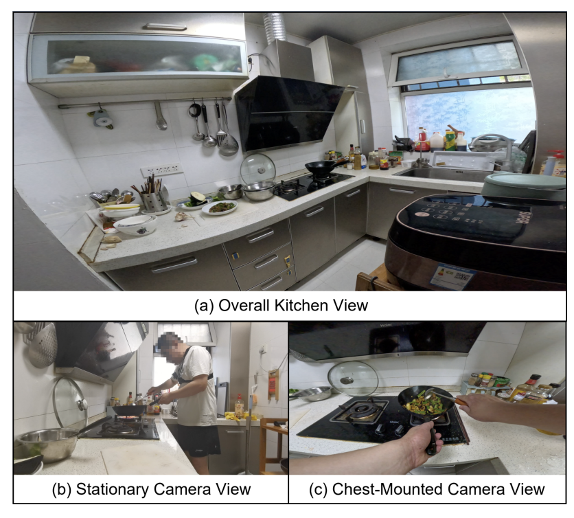
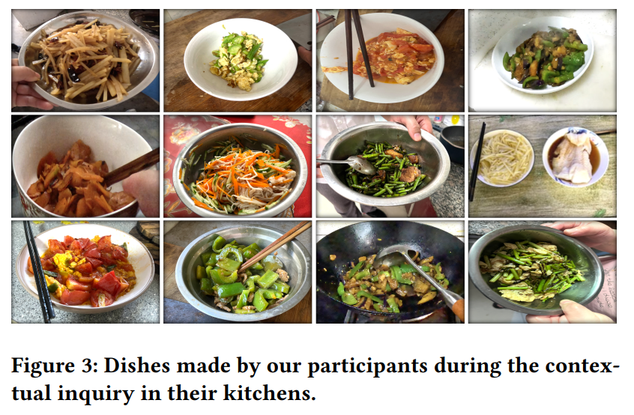
Examples of CI:
Design to support the visually impaired people in cooking (paper link)

Slide 36
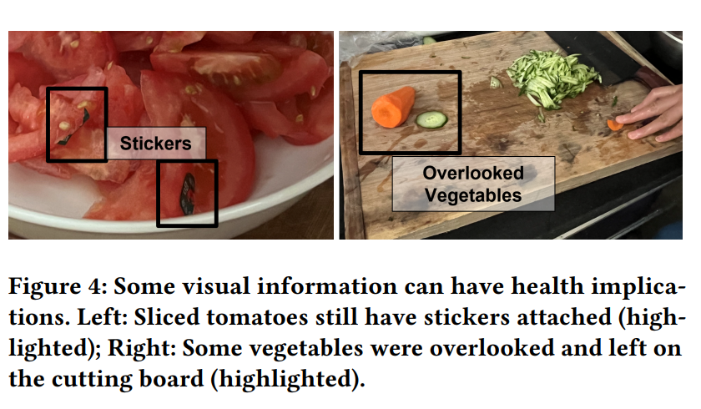
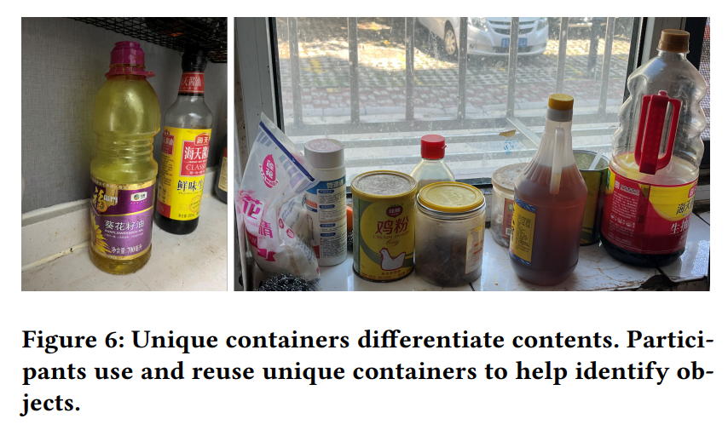
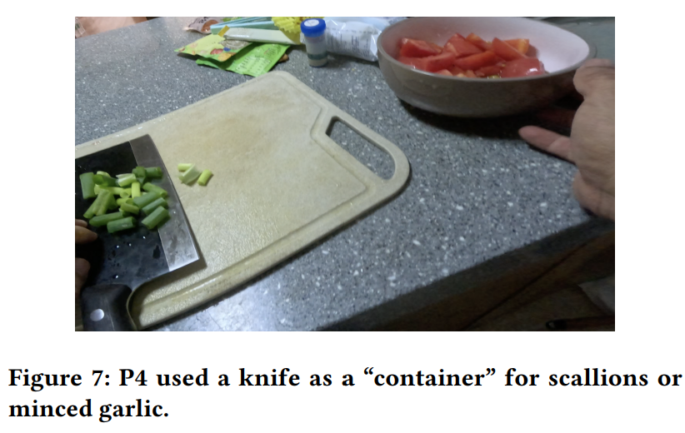
Examples of CI:
Design to support the visually impaired people in cooking (paper link)

Slide 37
Contextual Inquiry: A few guidelines
Gaining access and building rapport
Before you can do anything in an ethnographic project, you must gain access to your site and informants
Must additionally gain confidence and trust
Recognize some potential reactions you could have
- Excitement about the project and site
- Culture shock
- Cycle of entering and leaving can have an emotional impact

Slide 38
Contextual Inquiry: A few guidelines
Recording your observation
Video recording
Note taking and memos
Interviewing
Be mindful of your access permissions and participant’s comfort levels

Slide 39
Contextual Inquiry: A few guidelines
What to record
Begin with your research questions
Do not overly constrain yourself
Take notes on
-What is directly relevant
- What strikes you as interesting
- Everything else

Slide 40
Contextual Inquiry: A few guidelines
The process of recording
Your data are only as good as you are
Sometimes it is possible to record in the moment
Other times it must be done after the event
- Write down the important things first
- Then replay the day and slot them into order

Slide 41
Contextual Inquiry
Strengths
Extremely rich data
-You get to watch what people do and talk to them!
“Real world” and unfiltered, or as close as you can get
The methods are led by participant’s needs and interests, not your preconceived notions

Slide 42
Contextual Inquiry
Weakness
Participants do not necessarily know what is important to you
- Probing questions or observation can help, but they’re not sufficient
People’s memories are warped and flawed
- They may say one thing in interviews and do another in practice
The methods are resource-intensive
You can hear from tens of people at best, making generalization challenging
Participants can find it awkward to be watched or open up

Slide 43
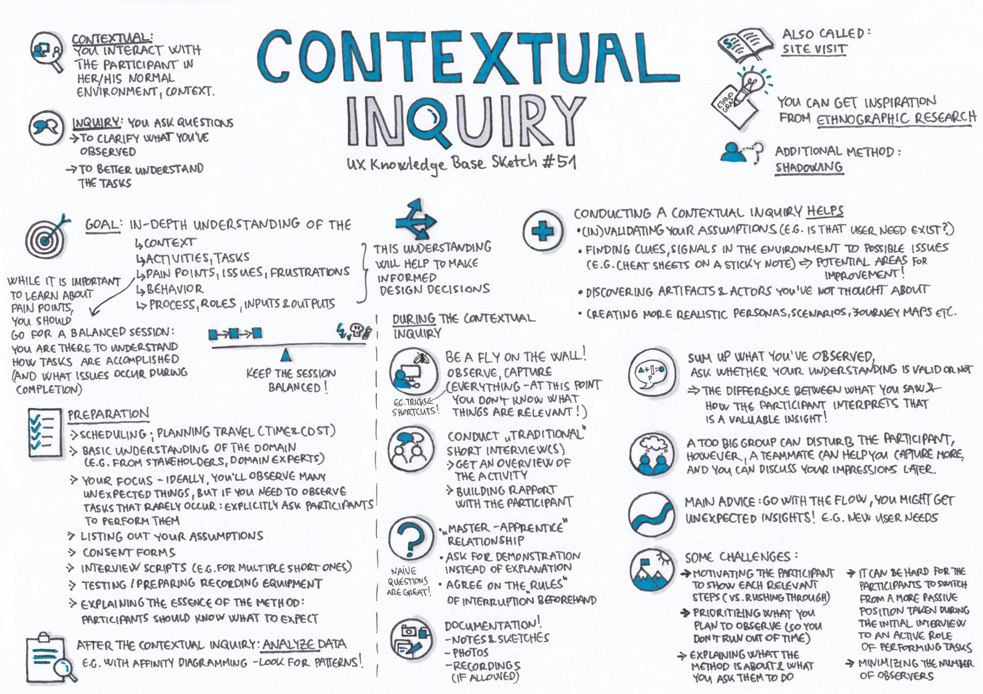

Slide 44
Surveys and questionnaires
Structured set of questions a person responds to
Much more structured than most qualitative techniques
But… does not have to be strictly quantitative
It is very easy to design a bad questionnaire
How many terrible surveys have you taken?

Slide 45
Getting people to respond
Increase perceived rewards
- Provide information about the survey and goals
- Ask for help or advice
- Say thank you
- Give tangible rewards
- Support a group’s values
- Make the questionnaire interesting
Establish trust
- Lean on your role/organization
- If payment is provided, give it in advance
- Make the task feel important (possibly more important than it is)
- Ensure confidentiality and security (and anonymity when necessary)
Decrease perceived costs
- Make it convenient to complete
- Make it as short as possible
- Minimize requests for identifiable or sensitive information

Slide 46
Surveys and Questionnaires
Answers can lead to question forks
“If you have used Snapchat in the last week…”
Make yourself a flowchart so you don’t get lost
Online tools make this easier than paper
Be aware of length issues resulting from these forks

Slide 47
Surveys and Questionnaires
For each question, ask:
Do I need to know that?
Do I need to know it at that level of detail?
How you word the question will impact results
Pilot with your friends
Then, with people who are not your friends
Open-ended
Close-ended (scalar)
Nominal: compare a set of categories (e.g., colors)
Ordinal: ordered set of categories (e.g., strongly disagree, agree)
Partially closed
Has an “other” option

Slide 48
Surveys and Questionnaires (Tips)
Make sure question applies to respondent and then requires an answer
Ask one question at a time
Use simple and familiar words, no acronyms
Use well-defined words
Use complete but simple sentences
Avoid double negatives
Match the question to the responses
Ensure that you’re not accidentally introducing biases through use of color,
bolding, fonts, etc.
Check spacing and alignment on various screen sizes/orientations
Participants will see relationships, group questions, etc. based on how you have them laid out

Slide 50
Activity
Designing a Better Shared Study Space for Students
Background: Your university library is planning to redesign its shared study areas (quiet rooms, group tables, computer labs, and informal lounge spaces). They want to create an environment that supports both individual and collaborative study, reduces stress, and encourages healthy study habits. The library team has asked your research group to investigate students’ current behaviors, needs, and preferences — and to provide design recommendations.
Goal: To understand how students currently use library study spaces, what problems they face, and what features or tools would make these spaces more effective, inclusive, and enjoyable.
To Do:
Identify which methods would be suitable for this problem space
Write down 3 to 4 requirements that the selected method would be able to uncover

